Slide 1
CSE 3105
Software Engineering

Slide 2
Integration Testing
Top-Down Integration
Bottom-Up Integration
Regression Testing
Smoke Testing

Slide 3
Integration Testing
Integration testing is a systematic technique for constructing the software architecture while at the same time conducting tests to uncover errors associated with interfacing.

Slide 4
Regression Testing
A representative sample of tests that will exercise all software functions.
Additional tests that focus on software functions that are likely to be affected by the change.
Tests that focus on the software components that have been changed.

Slide 5
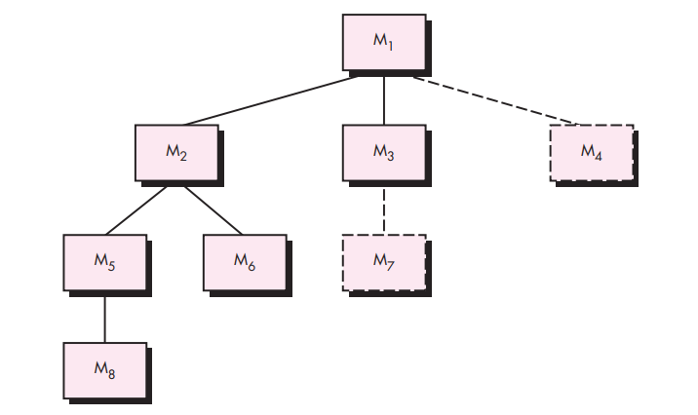
Top-Down Integration

Slide 6
Top-Down Integration
1. The main control module is used as a test driver and stubs are substituted for all components directly subordinate to the main control module. 2. Depending on the integration approach selected (i.e., depth or breadth first), subordinate stubs are replaced one at a time with actual components. 3. Tests are conducted as each component is integrated. 4. On completion of each set of tests, another stub is replaced with the real component. 5. Regression testing may be conducted to ensure that new errors have not been introduced.

Slide 7
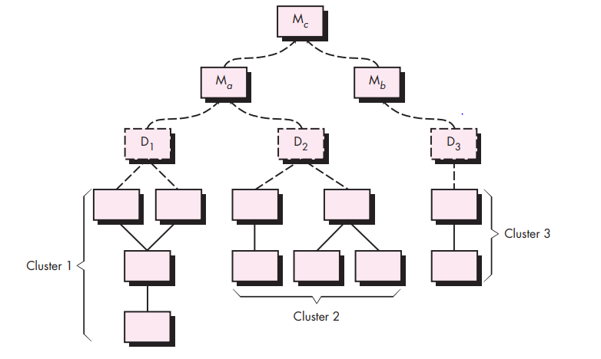
Bottom-Up Integration

Slide 8
Bottom-Up Integration
Low-level components are combined into clusters (sometimes called builds) that perform a specific software subfunction.
A driver (a control program for testing) is written to coordinate test case input and output.
The cluster is tested.
Drivers are removed and clusters are combined moving upward in the program structure

Slide 9
Smoking Test
Software components that have been translated into code are integrated into a build. A build includes all data files, libraries, reusable modules, and engineered components that are required to implement one or more product functions.
A series of tests is designed to expose errors that will keep the build from properly performing its function. The intent should be to uncover “showstopper” errors that have the highest likelihood of throwing the software project behind schedule.
The build is integrated with other builds, and the entire product (in its current form) is smoke tested daily. The integration approach may be top down or bottom up.

Slide 10
Thank You

